Slide 1


Airbnb New User Bookings
By
Menna Elminshawy

Slide 2



Data processing

Slide 3
First step

Slide 4

sessions data
Duplicated in ID =10567737
We dropped the duplicated
Then we merged sessions data frame with train users

Slide 5
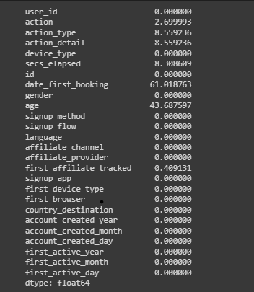
Handling NULL
We can clearly see that there are a lot of null in the data

Slide 6
First NULL in age
We First saw that there are people who put their age wrong as put the year of birth not the age
So, we subtracted this with the account created year
They were still outliers as people age be 150 but we left it as it may be helpful
And we left the outlies who also are very young

Slide 7

What did we do to the nulls ?
We couldn't drop the null
We couldn't put the mode or mean in null (as it may make unbalanced in data )

Slide 8
BUT why do need to erase Null ?
Null may be useful to determine what the person is thinking or if he will even book
So, we put it in a value called Don't Know in all columns

Slide 9
Feature engineering
We split date account created and timestamp first active in Year/Month/ Day

Slide 10

Visualization

Slide 11
what are our first conclusion?

Slide 12
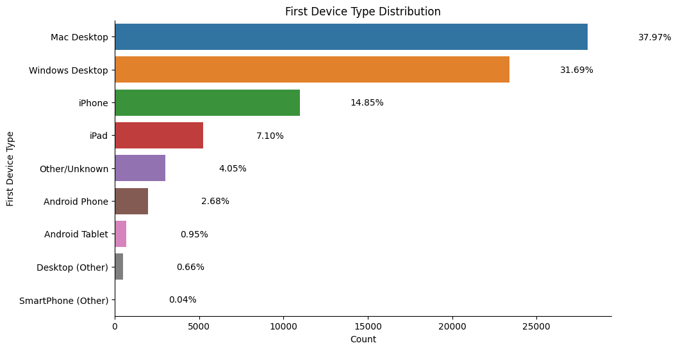
First Device Type Distribution
There are more Mac users than the rest
Is the user experience bad in other Devices!!

Slide 13
What did we see next ?

Slide 14
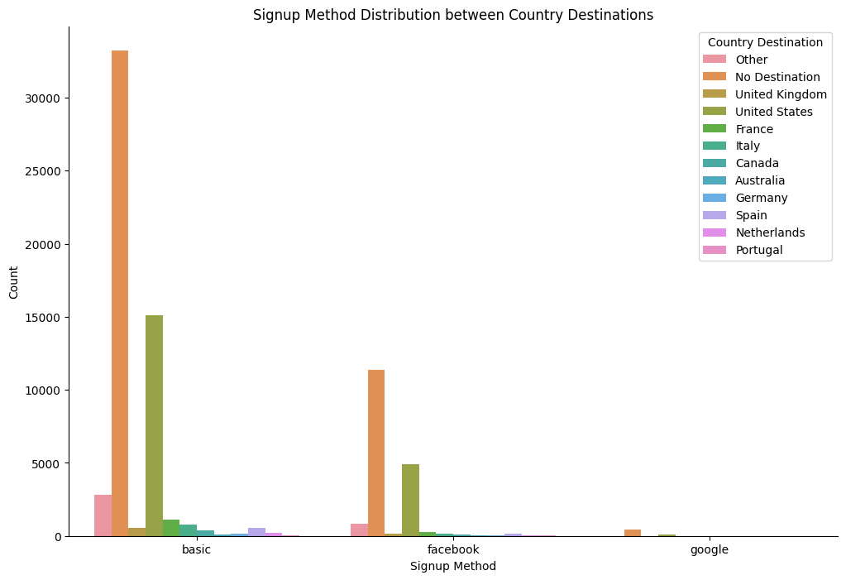
Signup Method Distribution between Country Destinations
We noticed that United states and No Destination are the most
Let's zoom a little on the rest of the countries

Slide 15
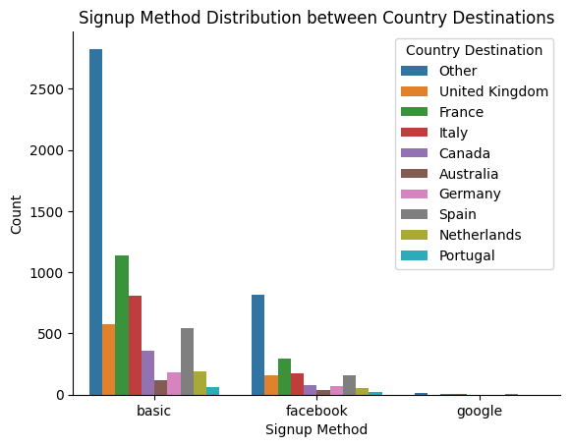
Signup Method Distribution between Country Destinations
Why Others are the most ?
Do we have enough countries ?

Slide 16
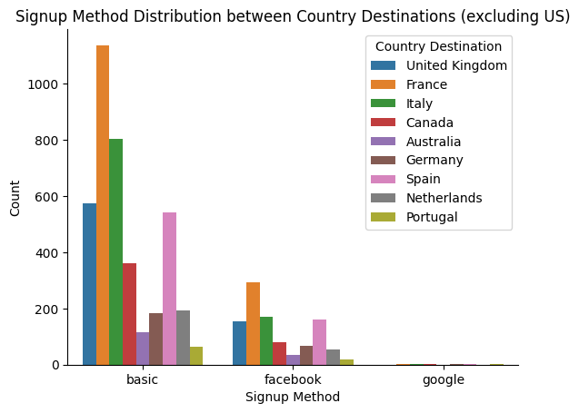
Method Distribution between Country Destinations (excluding UsA and Other)
Now we can see that France has the most count
But is it good?

Slide 17
What are the next important thing?

Slide 18
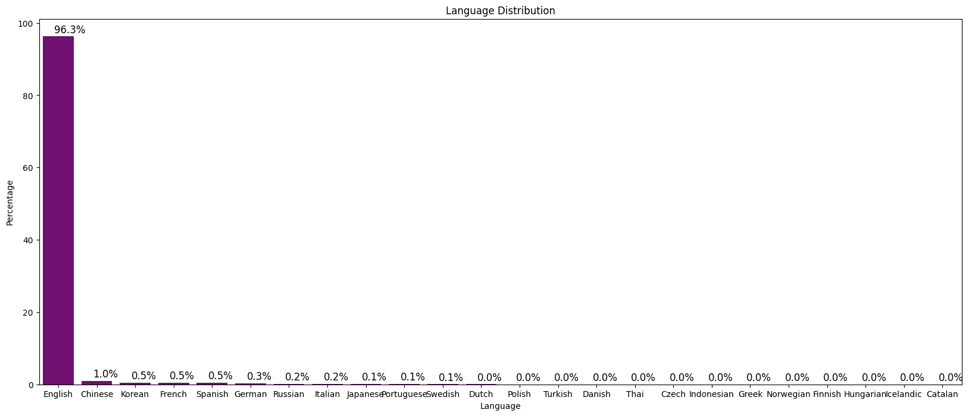
Language Distribution

Slide 19
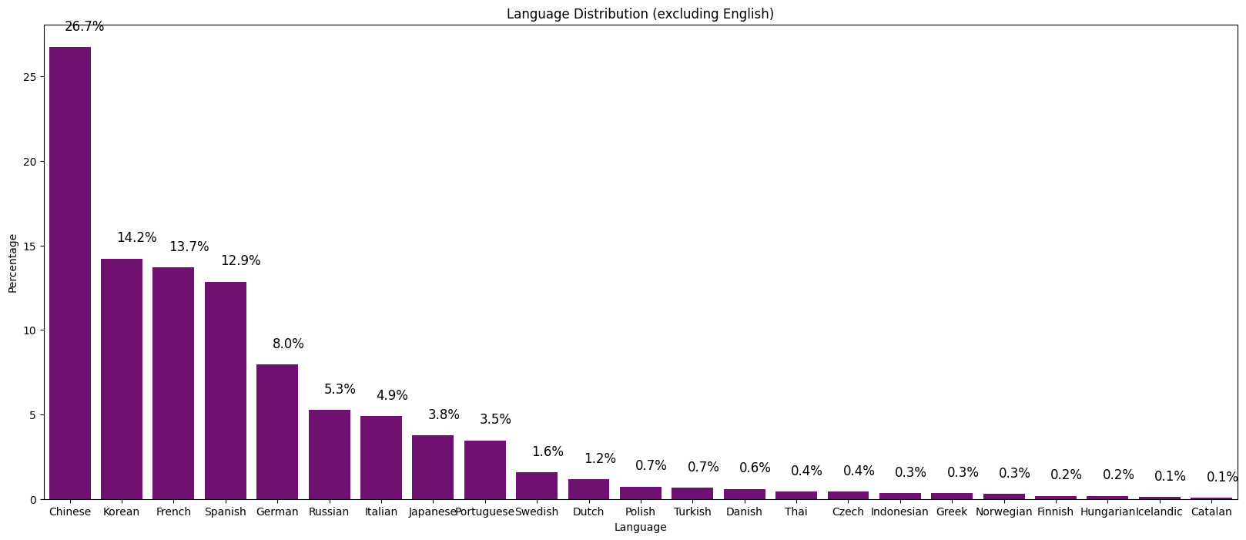
Language Distribution (excluding English)

Slide 20
Will the Language affect where you go?

Slide 21
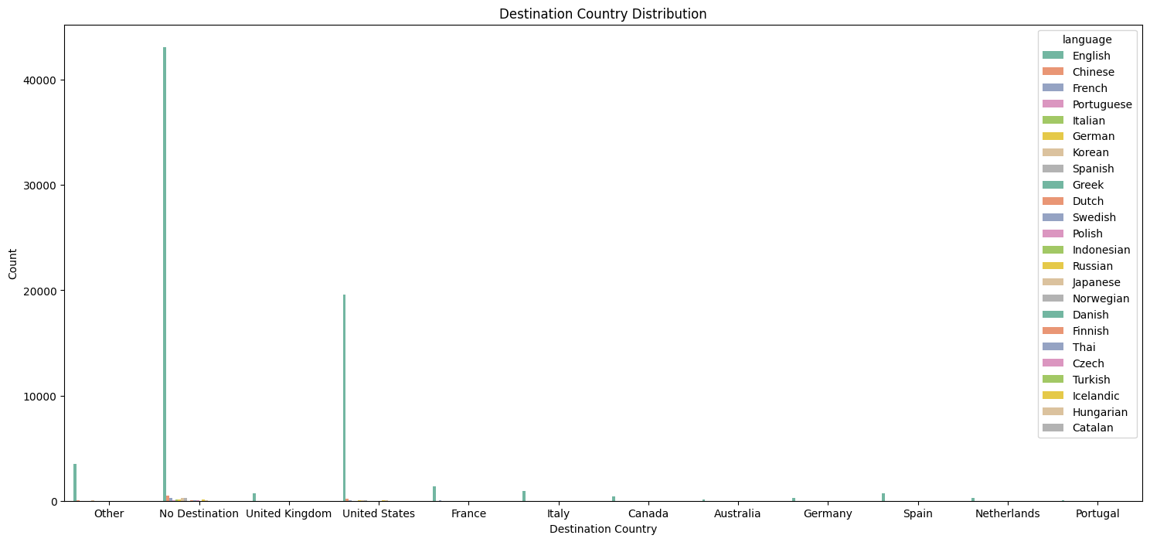
Destination Country

Slide 22
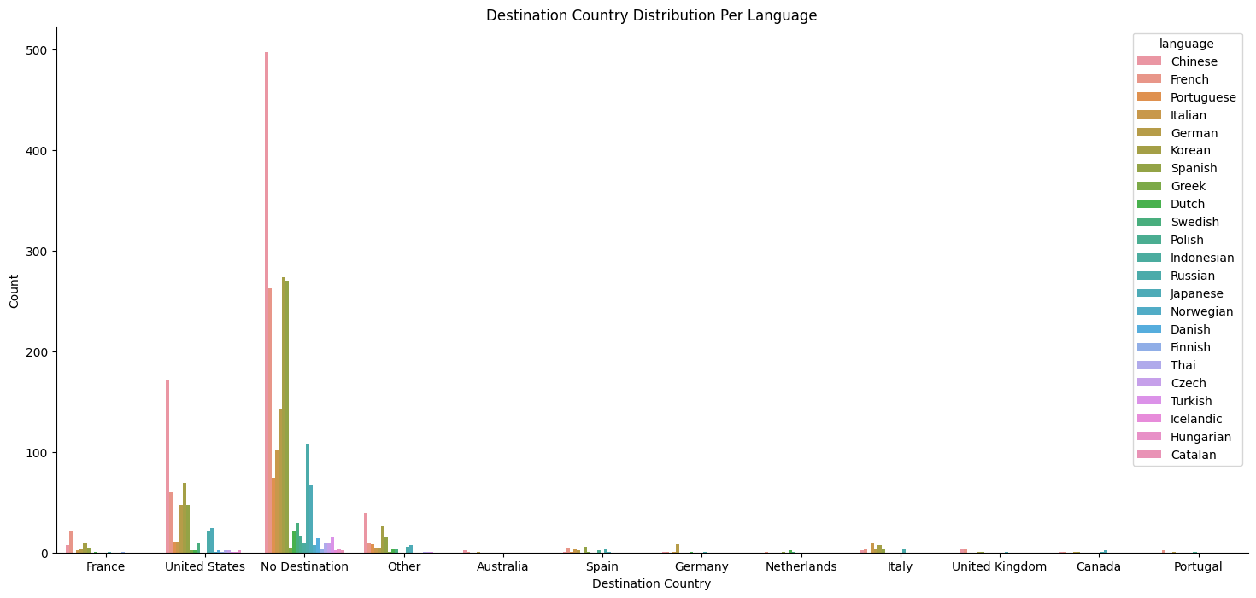
Destination Country without English

Slide 23
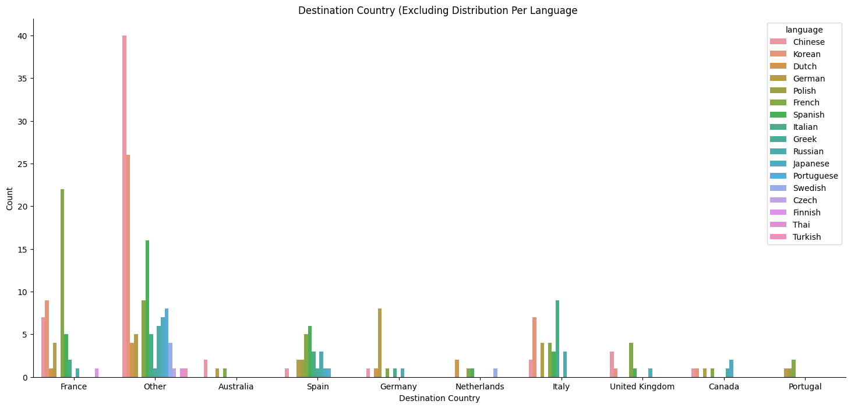
Destination Country without English and USA and NDF

Slide 24
who will most likely book?

Slide 25
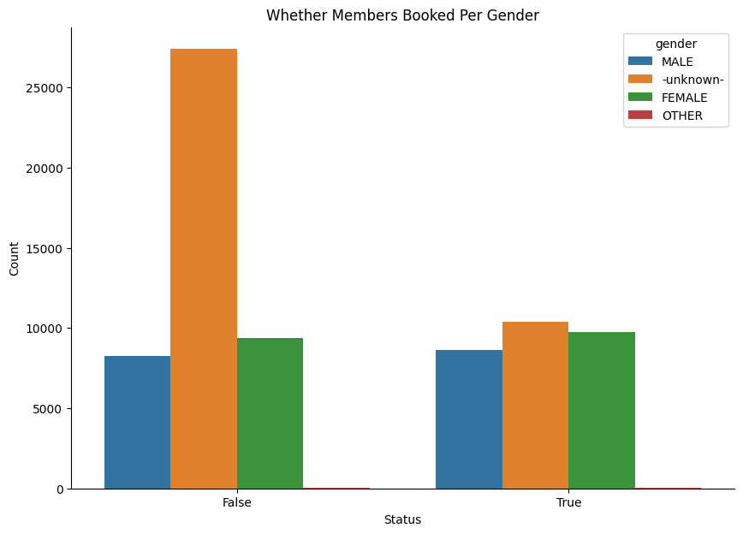
Whether Members Booked Per Gender
So, does that mean that most people make their gender unknown to only view the sight?

Slide 26
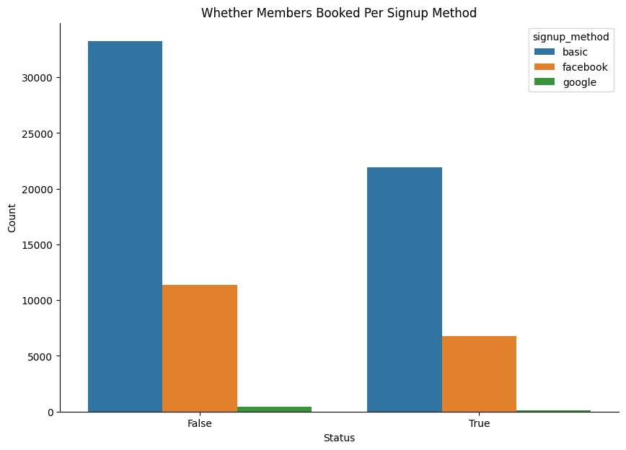
Whether Members Booked Per Signup Method?

Slide 27
What are the most important age group?

Slide 28
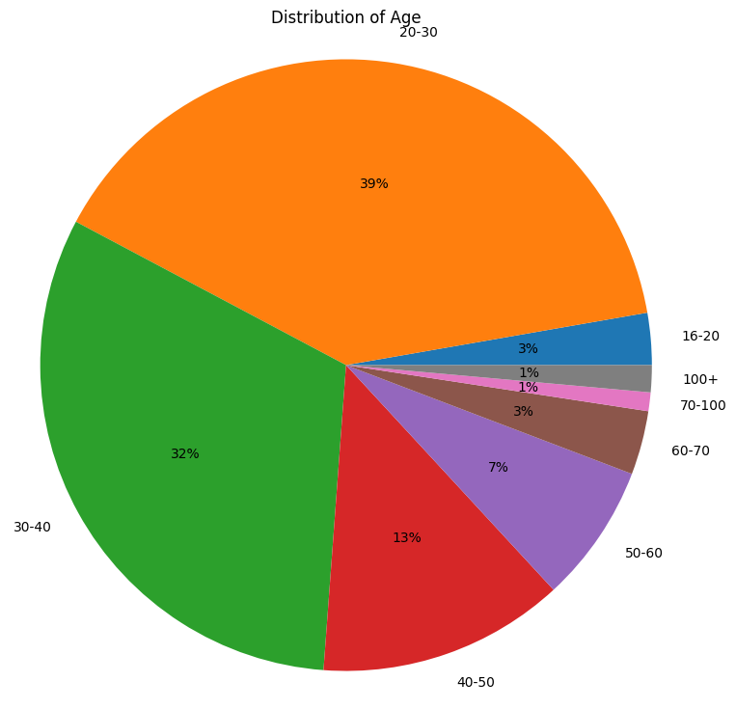
Distribution of age

Slide 29
What are the most important time of weekdays & months?

Slide 30
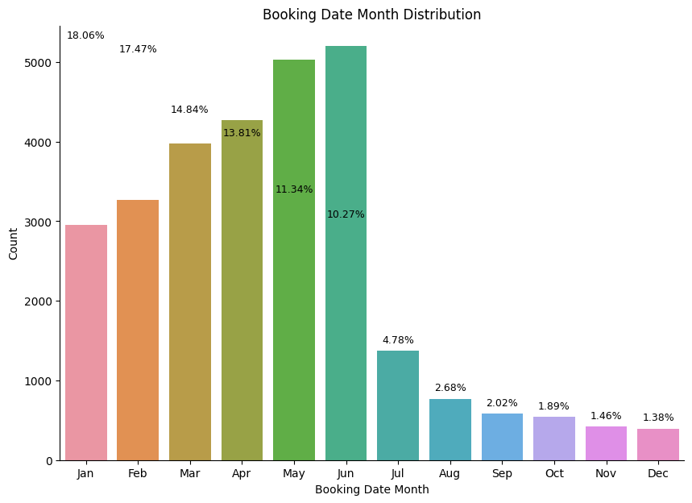
Booking Date Month Distribution

Slide 31
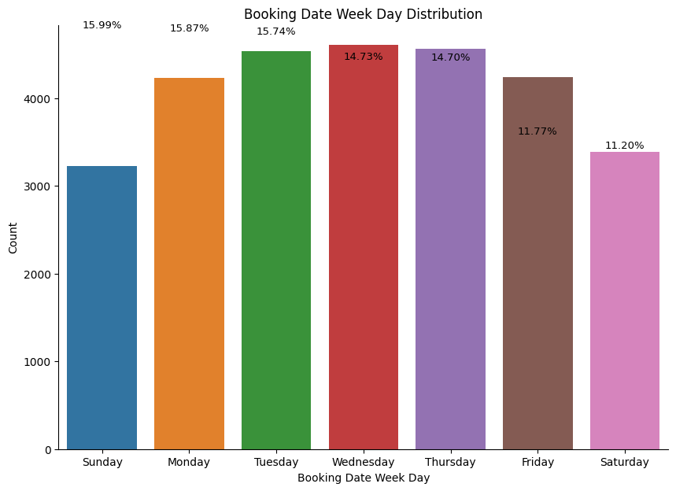
Booking Date Weekday Distribution

Slide 32
What are the Correlation between columns?

Slide 33
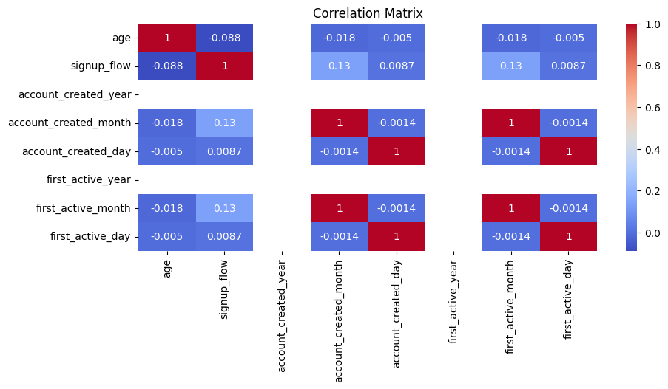
Correlation Matrix

Slide 34
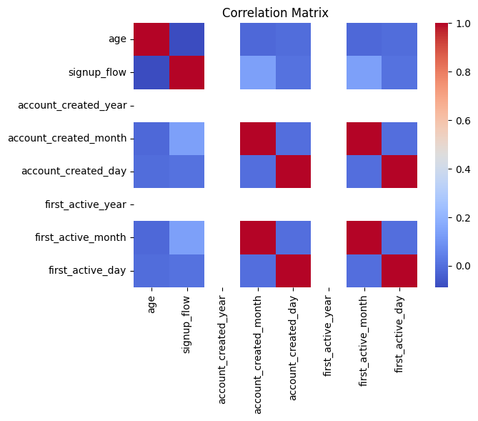
Correlation Matrix

Slide 35

Now we will begin the fun part

Slide 36

Machine learning

Slide 37

What are the strategies we used ?
Random Forest Classifier
Xgboost Classifier
Logistic Regression
IMBLEARN Random Forest Classifier
IMBLEARN Logistic Regression
SMOTE

Slide 38
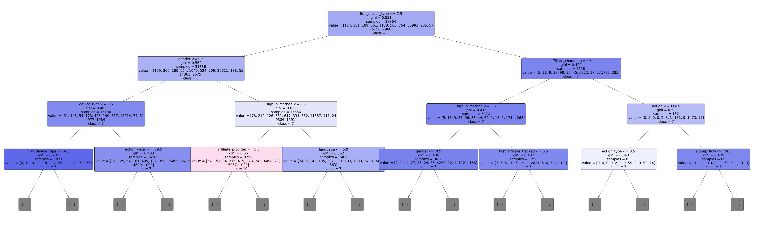
Random Forest Classifier
How dose it work ?

Slide 39


Slide 40
What was the important Features?
'action’
'action detail’
'gender’
'affiliate channel’
'first affiliate tracked’
'first browser’
'account created month’
'first active month'

Slide 41
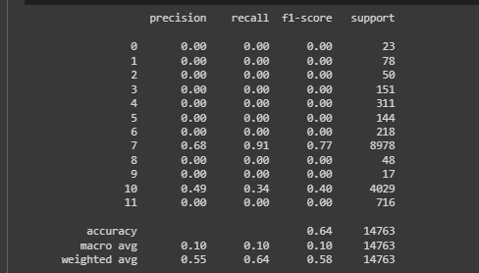
What are the Accuracy?
Accuracy: 65.51175235385762
Precision: 63.92016057644387
Recall: 65.51175235385762
F1-score: 59.62405841173238

Slide 42
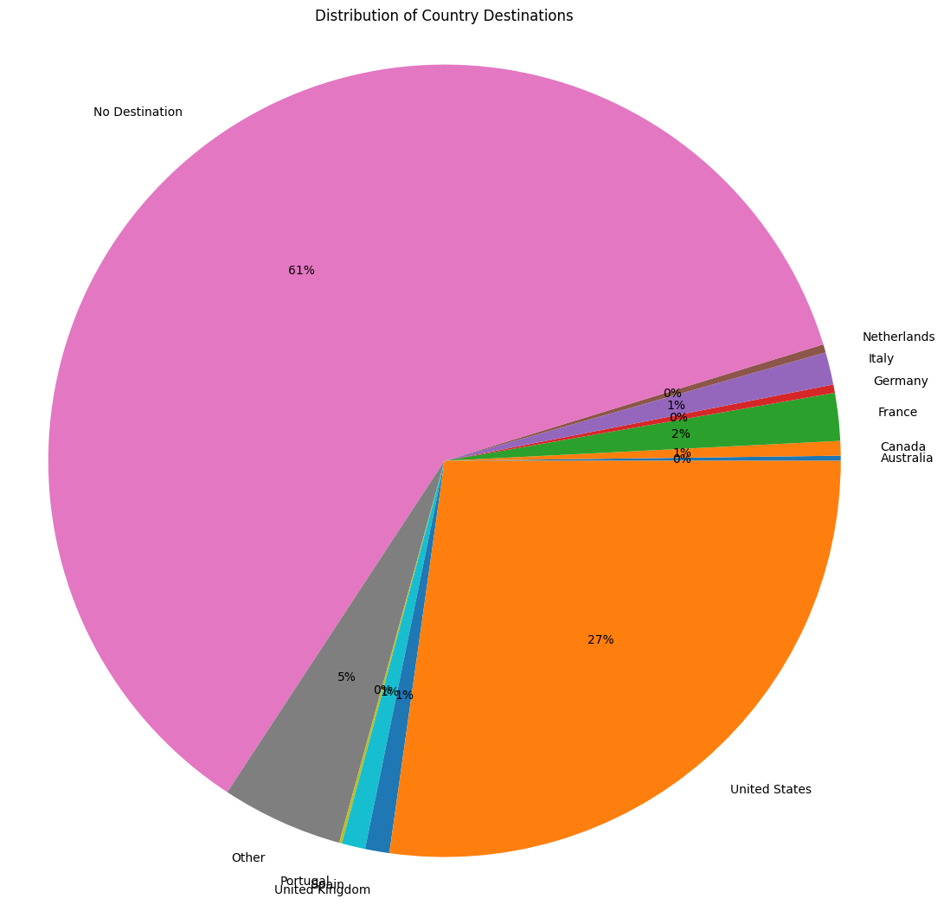
There was a problem !!!
We have a huge unbalanced in the data

Slide 43
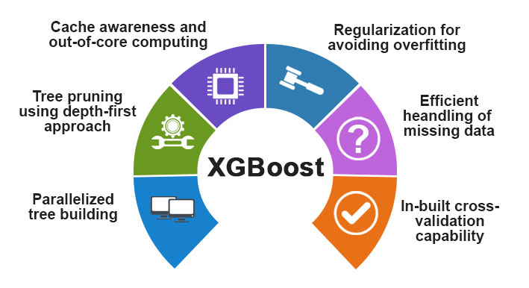
Xgboost Classifier
Helps in unbalanced

Slide 44
What was the important Features?
'action detail’
'gender’
'signup method’
'signup flow'

Slide 45
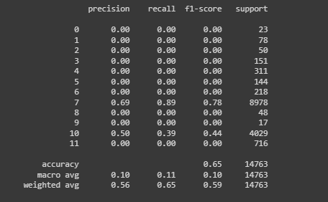
What are the Accuracy?
Accuracy: 65.96389622705412
Precision: 65.26409524074601
Recall: 65.96389622705412
F1-score: 60.54278958736179

Slide 46
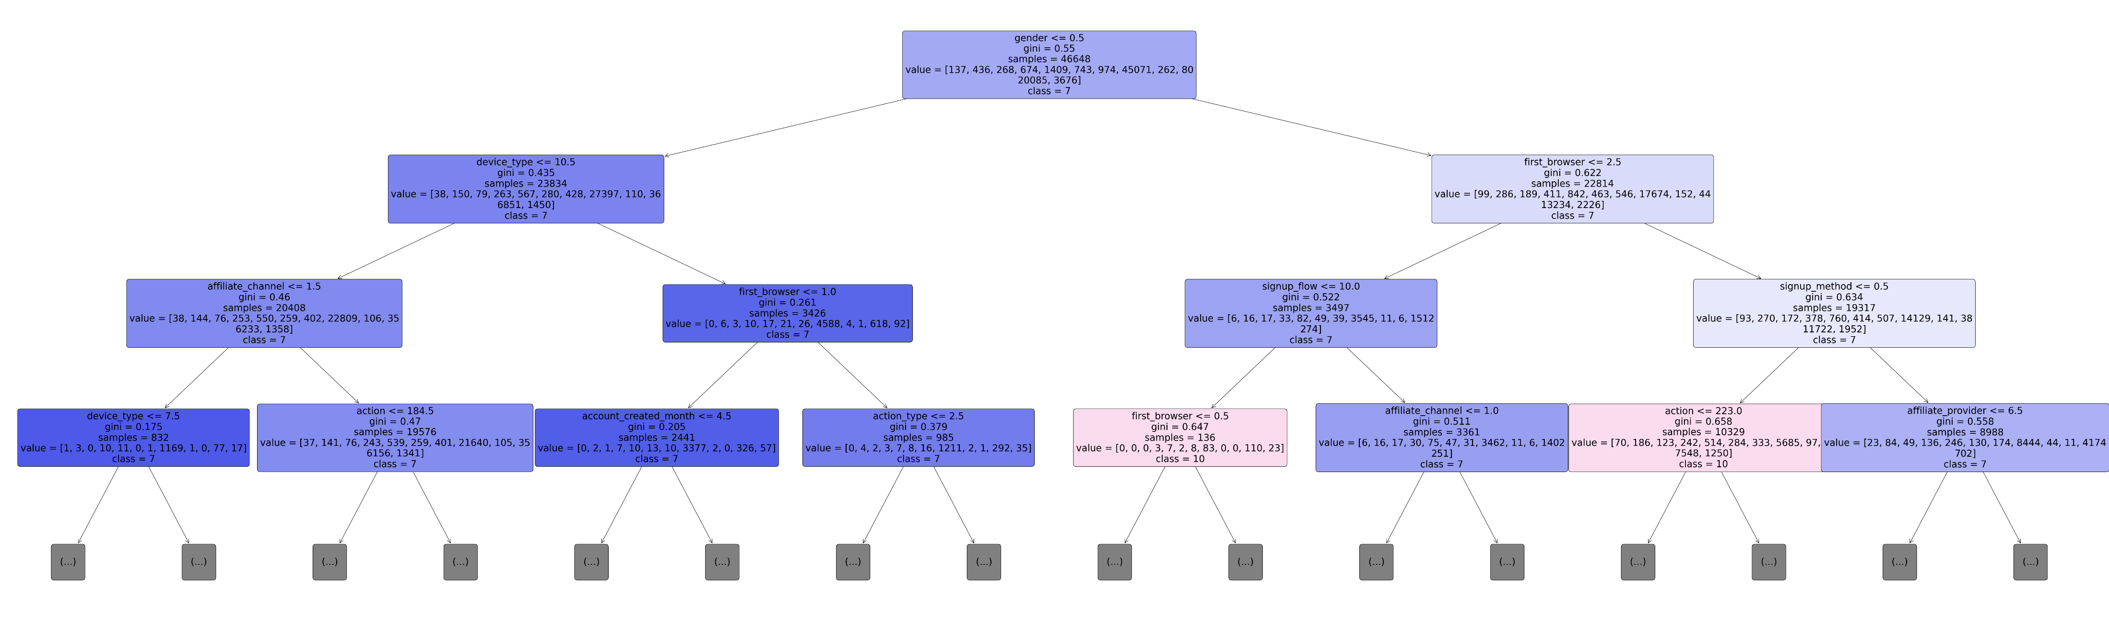
SMOTE

Slide 47
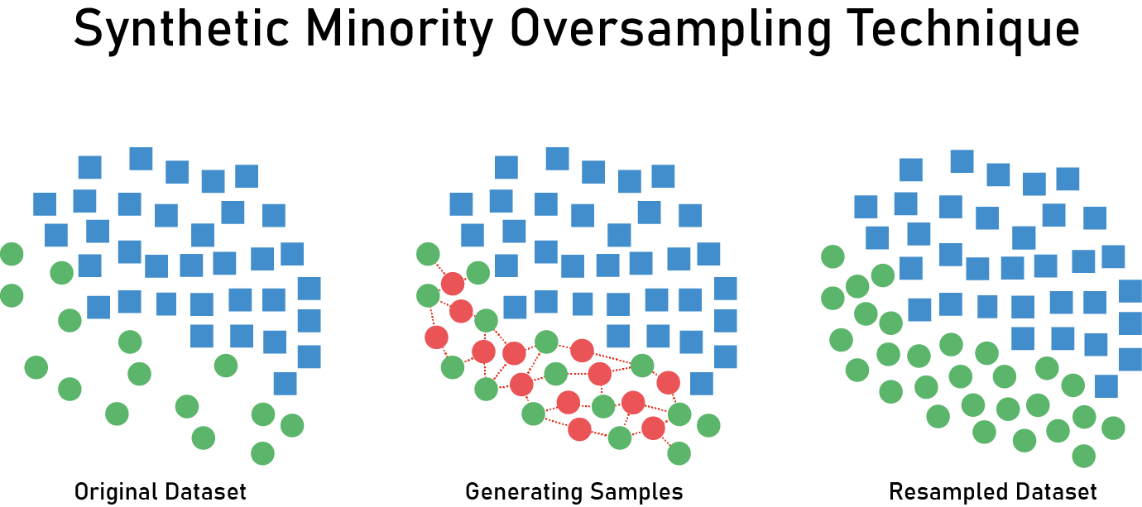
Synthetic Minority Oversampling Technique (SMOTE)
Technique for increasing the number of cases in your dataset
Creating data points that are slightly different from the original data points

Slide 48


Slide 49
What was the important Features?
'action’
'action detail’
'gender’
'affiliate channel’
'first affiliate tracked’
'first browser’
'account created month’
'first active month'

Slide 50
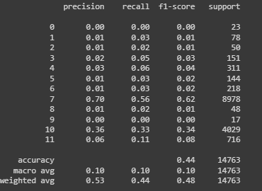
What are the Accuracy?
Accuracy: 71.77402966876651
Precision: 79.99021552463382
Recall: 71.77402966876651
F1-score: 74.537837739143

Slide 51
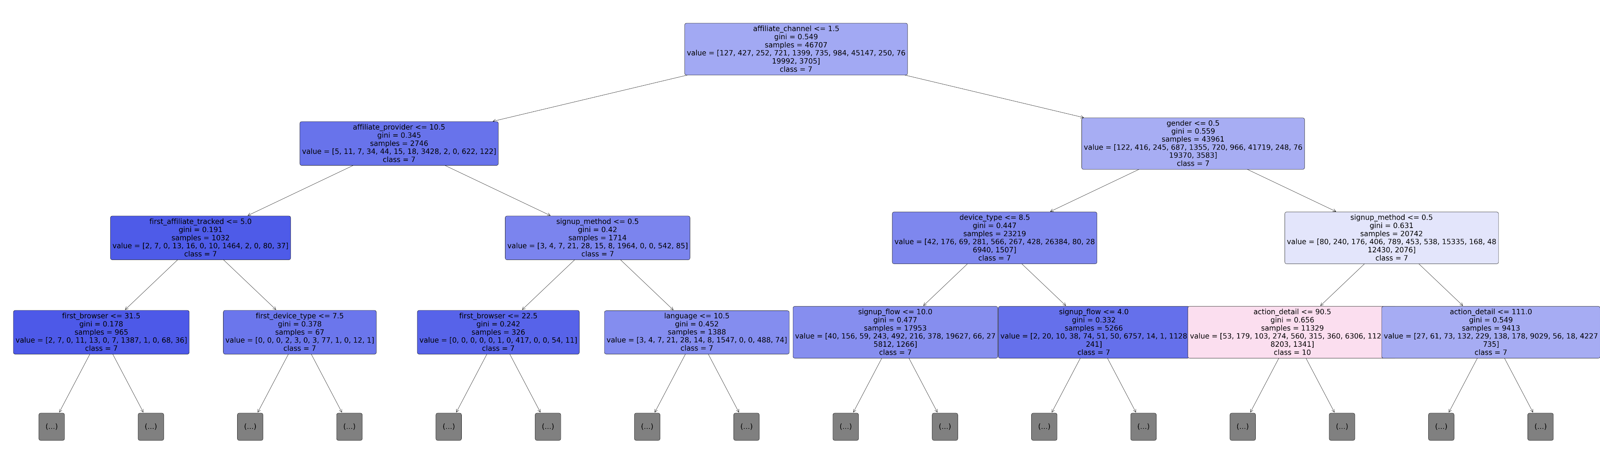
IMBLEARN Random Forest Classifier

Slide 52

What are IMBLEARN ?
Methods by which we can generate a data set that has an equal ratio of classes.
We have two options to treat an imbalanced data set that are Oversampling and Under sampling.
In our datasets we used Undersampling on Not Defined

Slide 53


Slide 54
What was the important Features?
'action’
'action detail’
'gender’
'affiliate channel’
'first affiliate tracked’
'first browser’
'account created month’
'first active month'

Slide 55
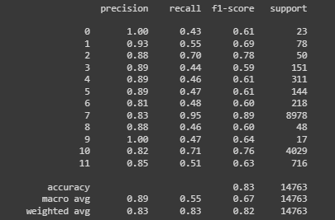
What are the Accuracy?
Accuracy: 82.79990516832622
Precision: 82.88420158170248
Recall: 82.79990516832622
F1-score: 81.86579873664737

Slide 56
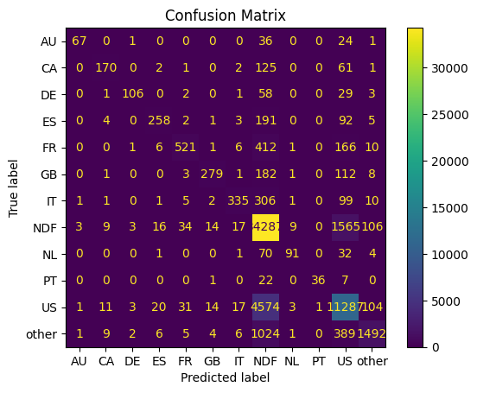
Confusion Matrix Display

Slide 57
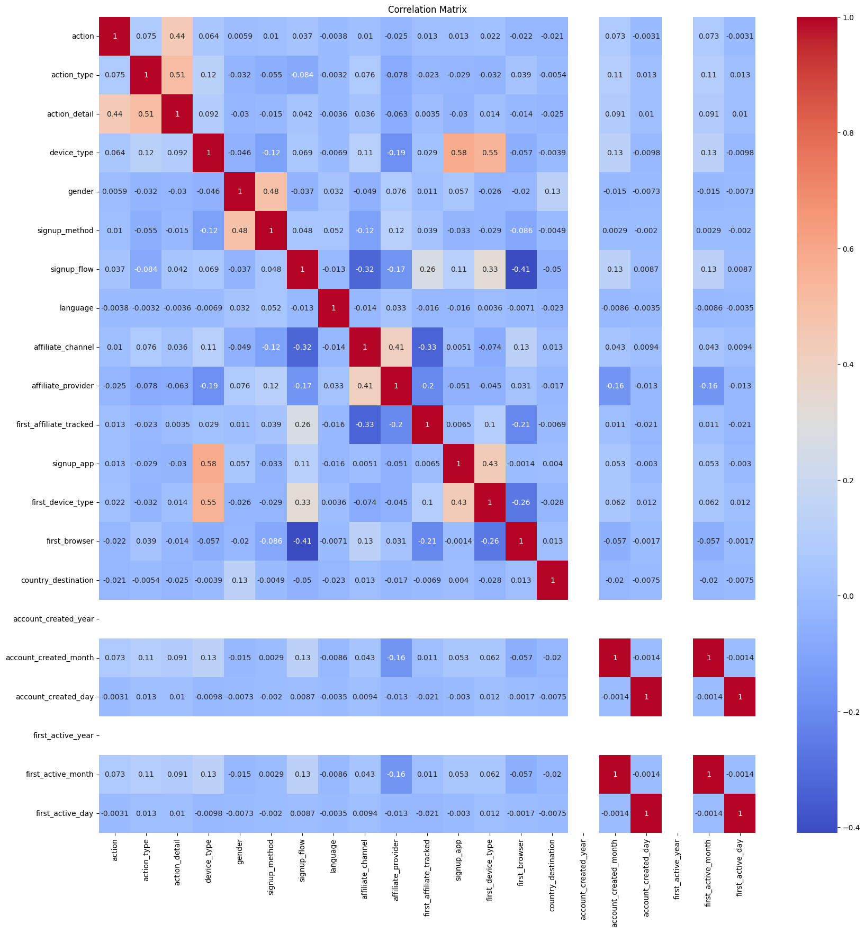

Slide 58



Thank you

